Slide 1
Operating Systems – (3 easy pieces)
Dr. B. Wajid
Wednesday: Oct. 30, 2024

Slide 2
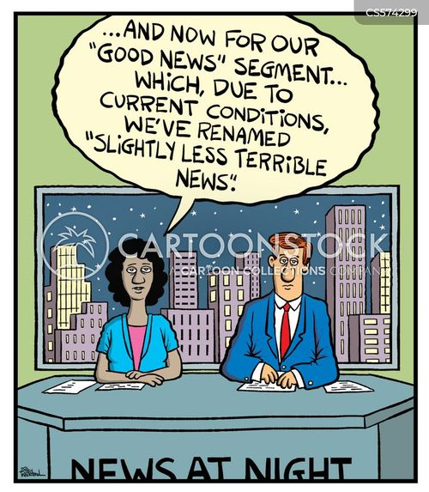

Slide 3
Items for today:
Segmentation.
Introduction to “Free Space Management”: lengthy topic so, we start today and end in the next lecture
Mighty QUIZ.

Slide 4
Virtual Memory
0KB
Program Code
1KB
Virtual memory comprises three segments.
Code.
Heap.
Stack.
A segment is simply a contiguous portion of the address space of a particular length.
You will also notice a “big chunk of free.”
This “free” is not an illusion, it does take up physical memory.
Memory can not be allocated if the process demands more and less is available.
Question: You have 1 Panadol pill and 2 people with aches. What will you do? … Think …
2KB
3KB
4KB
5KB
Heap
6KB
(free)
14KB
15KB
Stack
16KB

Slide 5
Virtual Memory
Base
0KB
1KB
Program Code
This implementation requires a pair of base and bound for address translation.
Each process requires three fundamental entities:
Code: (1) Program Counter
Memory: (2) Base and the (3) Bounds register
Again, a lot of space is wasted as free space … so let’s do Segmentation.
2KB
3KB
4KB
5KB
Heap
6KB
(free)
14KB
15KB
Stack
Bound
16KB

Slide 6
Segmentation
0KB
Operating System
16KB
(not in use)
Segment Base Size
Code 32K 2K
Heap 34K 2K
Stack 28K 2K
Stack
(not in use)
32KB
Code
Heap
(not in use)
48KB
64KB
Physical Memory

Slide 7
Segmentation
0KB
Operating System
16KB
(not in use)
Segment Base Size
Code 32K 2K
Heap 34K 2K
Stack 28K 2K
Stack
(not in use)
32KB
Code
Heap
(not in use)
Same as the Bounds Register
48KB
64KB
Therefore, 3 segments require 3 (base, size) pairs.
Physical Memory

Slide 8
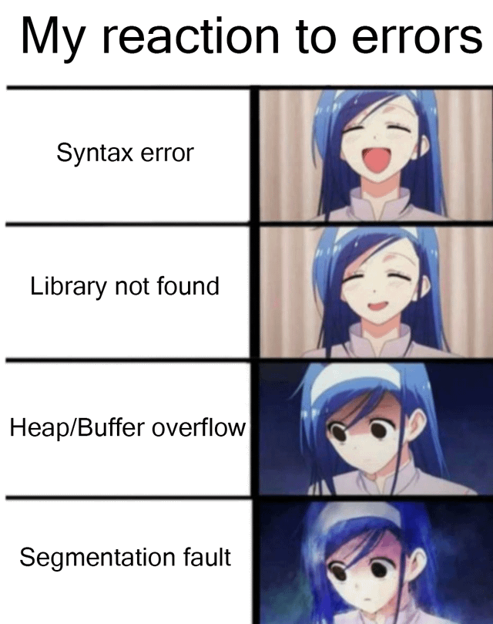
Segmentation Fault
The term segmentation fault or violation arises from memory access on an illegal address.

Slide 9
Segmentation fault
4KB
If an illegal address such as 7KB which is beyond the end of heap is referenced, the OS occurs segmentation fault.
The hardware detects that address is out of bounds.
Heap
6KB
7KB
(not in use)
8KB
Address Space

Slide 10
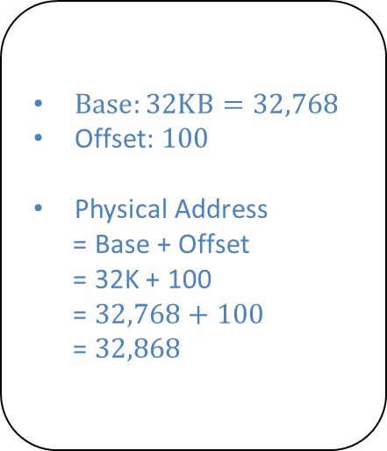
Address Translation – Code Segment
Segment Base Size
Code 32K 2K
16KB
$Base:32KB=32,768$
Offset: $100$
Physical Address
= Base + Offset
= 32K + 100
= $32,768+100$
= $32,868$
(not in use)
Base Address is 0KB.
Offset of the instruction is 100.
0KB
Code
32KB
100
Program Code
instruction
2KB
34KB
Heap
4KB
(not in use)
Address Space
Physical Memory

Slide 11
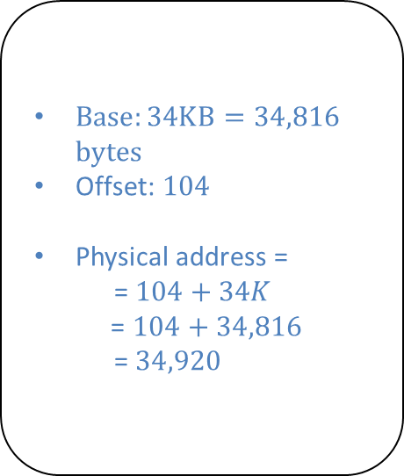
Address Translation – Heap Segment
Segment Base Size
Heap 34K 2K
(not in use)
$Base:34KB=34,816$ bytes
Offset: $104$
Physical address =
= $104+34K$
= $104+34,816$
= $34,920$
Base Address is 4KB.
Specific data is present at address 4200.
Address = Base + Offset
4200 = 4KB + Offset
Offset = 4200 – 4KB
= 4200 – 4096
= 104
32KB
Code
4KB
34KB
4200
Heap
Heap
data
6KB
36KB
(not in use)
Address Space
Physical Memory

Slide 12
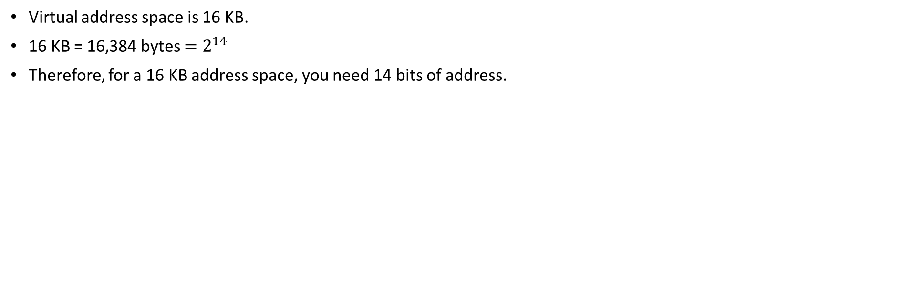
Referring to a Segment
Virtual address space is 16 KB.
16 KB = 16,384 bytes $=2^{14}$
Therefore, for a 16 KB address space, you need 14 bits of address.
13
12
11
10
9
8
7
6
5
4
3
2
1
0
Segment
Offset

Slide 13

Referring to a Segment
Explicit approach: Chop up the address space into segments based on the top few bits of virtual address.
Example: virtual address 4200 $≡$ Physical address with (Base: 34KB) and (Offset: 104)
Therefore, 4200 Virtual address $≡$ Within Heap (01) and offset of 104 $≡ ×068$H = (000001101000)
13
12
11
10
9
8
7
6
5
4
3
2
1
0
Segment
Offset
16,384 bytes
16,384 bytes
Segment bits
Code 00
Heap 01
Stack 10
- 11
13
12
11
10
9
8
7
6
5
4
3
2
1
0
0
1
0
0
0
0
0
1
1
0
1
0
0
0
Segment
Offset

Slide 14
Referring to a Segment
1 // get top 2 bits of 14-bit VA
2 Segment = (VirtualAddress & SEG_MASK) >> SEG_SHIFT
3 // now get offset
4 Offset = VirtualAddress & OFFSET_MASK
5 if (Offset >= Bounds[Segment])
6 RaiseException(PROTECTION_FAULT)
7 else
8 PhysAddr = Base[Segment] + Offset
9 Register = AccessMemory(PhysAddr)
SEG_MASK = 0x3000(11000000000000)
SEG_SHIFT = 12
OFFSET_MASK = 0xFFF (00111111111111)
B. Wajid

Slide 15
Referring to a Stack Segment
Stack grows backward.
Extra hardware support is need.
The hardware checks which way the segment grows.
1: positive direction, 0: negative direction
Segment Register(with Negative-Growth Support)
(not in use)
Segment Base Size Grows Positive?
Code 32K 2K 1
Heap 34K 2K 1
Stack 28K 2K 0
26KB
Stack
28KB
(not in use)
Physical Memory

Slide 16
Support for Sharing
Segment can be shared between address space.
Code sharing is still in use in systems today.
by extra hardware support.
Extra hardware support is need for form of Protection bits.
A few more bits per segment to indicate permissions of read, write and execute.
Segment Register Values(with Protection)
Segment Base Size Grows Positive? Protection
Code 32K 2K 1 Read-Execute
Heap 34K 2K 1 Read-Write
Stack 28K 2K 0 Read-Write

Slide 17
Grained – Fine and Coarse
Coarse-Grained means segmentation in a small number.
e.g., code, heap, stack.
Fine-Grained segmentation allows more flexibility for address space in some early system.
To support many segments, Hardware support with a segment table is required.

Slide 18
OS Support – Fragmentation
External Fragmentation: little holes of free space in physical memory that make difficulty to allocate new segments.
There is 24KB free, but not in one contiguous segment.
The OS cannot satisfy the 20KB request.
Compaction: rearranging the exiting segments in physical memory.
Compaction is costly.
Stop running process.
Copy data to somewhere.
Change segment register value.

Slide 19
Free Space Management – Memory Compaction
Not compacted
Compacted
0KB
Operating System
0KB
Operating System
8KB
8KB
16KB
16KB
(not in use)
Allocated
24KB
24KB
Allocated
32KB
32KB
(not in use)
40KB
Allocated
40KB
(not in use)
48KB
(not in use)
48KB
56KB
56KB
Allocated
64KB
64KB

Slide 20
Free Space Management – Splitting
Finding a free chunk of memory that can satisfy the request and splitting it into two.
When request for memory allocation is smaller than the size of free chunks.
30-byte heap:
free
used
free
0
10
20
30
addr:0
len:10
addr:20
len:10
free list:
head
NULL

Slide 21

Free Space Management – Splitting
Two 10-bytes free segment with 1-byte request
30-byte heap:
free
used
free
0
10
20
30
addr:0
len:10
addr:20
len:10
free list:
head
NULL
$$splitting 10−byte free segment$$
30-byte heap:
free
used
free
0
10
20 21
30
addr:0
len:10
addr:21
len:9
free list:
head
NULL

Slide 22

Free Space Management – Coalescing
If a user requests memory that is bigger than free chunk size, the list will not find such a free chunk.
Coalescing: Merge returning a free chunk with existing chunks into a large single free chunk if addresses of them are nearby.
addr:10
len:10
addr:0
Len:10
addr:20
len:10
head
NULL
$$coalescing free chunks$$
addr:0
len:30
head
NULL

Slide 23
Free Space Management – Tracking size of allocated region
The interface to free(void *ptr) does not take a size parameter.
How does the library know the size of memory region that will be back into free list?
Most allocators store extra information in a header block.
ptr = malloc(20);
The header used by malloc library
ptr
The 20 bytes returned to caller
An Allocated Region Plus Header

Slide 24

Quiz Time

